Slide 1
Project Cost Management

Slide 2
Learning Objectives
Understand the importance of project cost management
Explain basic project cost management principles, concepts, and terms
Discuss different types of cost estimates and methods for preparing them

Slide 3
Learning Objectives (continued)
Understand the processes involved in cost budgeting and preparing a cost estimate, and budget for an information technology project
Understand the benefits of earned value management and project portfolio management to assist in cost control
Describe how project management software can assist in project cost management

Slide 4
The Importance of Project Cost Management
IT projects have a poor track record for meeting budget goals
Interestingly, a study conducted by McKinsey found that 66% of enterprise software projects have cost overruns. A third of them go beyond the estimated schedule, and almost 20% of them fall short of promised benefits.

Slide 5
What Went Wrong?
The U.S. Internal Revenue Service (IRS) continues to provide examples of how not to manage costs
A series of project failures in the 1990s cost taxpayers more than $50 billion a year
In 2004, CIO Magazine reported problems with the IRS’s $8 billion modernization project
In 2006, the IRS was in the news for a botched upgrade to its fraud-detection software, costing $318 million in fraudulent refunds that didn’t get caught
The United Kingdom’s National Health Service IT modernization program was called the greatest IT disaster in history by a London columnist, with an estimated $26 billion overrun
Incompatible systems; resistance from physicians who felt they were not consulted enough about system features; arguments amoung contractors regarding responsibility

Slide 6
What is Cost and Project Cost Management?
Cost is a resource sacrificed or foregone to achieve a specific objective or something given up in exchange
Costs are usually measured in monetary units like dollars
Project cost management includes the processes required to ensure that the project is completed within an approved budget
Project managers must make sure their projects are well defined, have accurate time and cost sestimates and have a realistic budget that they were involved in approving

Slide 7
Reasons for Cost Overruns
Not emphasizing the importance of realistic project cost estimates from the outset
Many of the original cost estimates for IT projects are low to begin with and based on very unclear project requirements
Many IT professionals think preparing cost estimates is a job for accountants when in fact it is a very demanding and important skill that project managers need to acquire
Many IT projects involve new technology or business processes which involve untested products and inherent risks

Slide 8
Project Cost Management Processes
There are three project cost management processes:
Cost estimating: developing an approximation or estimate of the costs of the resources needed to complete a project
Cost budgeting: allocating the overall cost estimate to individual work items to establish a baseline for measuring performance
Cost control: controlling changes to the project budget

Slide 9
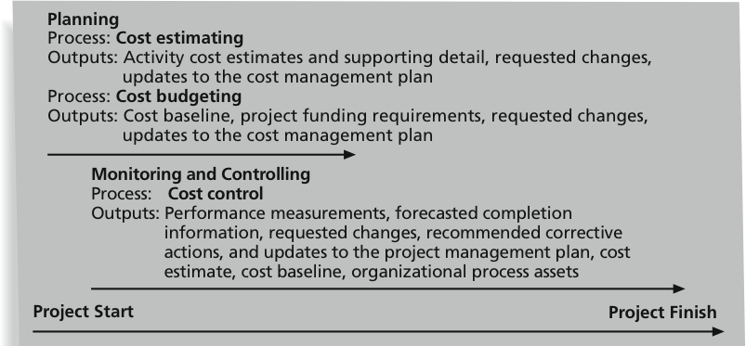
Project Cost Management Summary

Slide 10
Basic Principles of Cost Management
Most members of an executive board better understand and are more interested in financial terms than IT terms, so IT project managers must speak their language
Profits are revenues minus expenditures
Profit margin is the ratio of revenues to profits
$2 profit per $100 revenue → 2% profit margin
Life cycle costing considers the total cost of ownership, or development plus support costs, for a project
A project could take 2 years to build and be in place for 10 years; costs and benefits must be estimated for the entire lifetime of the project

Slide 11
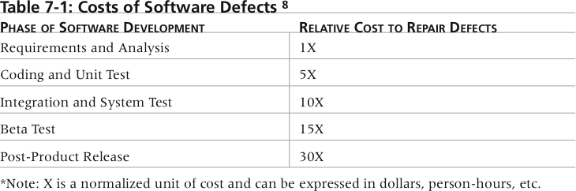
Cost of Software Defects
It is much more cost-effective to spend money on defining user requirements and doing early testing on IT projects than to wait for problems to appear after implementation
If it would cost $1,000 to repair a software defect in the requirements and analysis phase but it would cost $30,000 to fix it in the post-product release phase

Slide 12
What Went Right?
A leading telecommunications company estimated the cost of a software bug or defect at three stages: after coding, after manual inspection, and after beta release
The costs to correct the defect increased with each stage from $2,000 to $10,000 to $100,000
The company estimated that when it released one million lines of new code, it had an average of 440 defects in the early stage, 250 in the middle stage, and 125 in the late stage, costing more than $15 million
They decided to implement an automated inspection process, which reduced costs for fixing bugs by more than $11 million

Slide 13
Basic Principles of Cost Management
Cash flow analysis determines the estimated annual costs and benefits for a project and the resulting annual cash flow
Too many projects with high cash flow needs in the same year may not be able to be supported which will impact profitability
Tangible costs or benefits are those costs or benefits that an organization can easily measure in dollars
A task that was allocated $150,000 but actually costs $100,000 would have a tangible benefit of $50,000 if the assets allocated are used for other projects
Intangible costs or benefits are costs or benefits that are difficult to measure in monetary terms
Costs – resources used to research related areas of a project but not billed to the project
Benefits – goodwill, prestige, general statements of improved productivity not easily translated in dollars

Slide 14
Basic Principles of Cost Management
Direct costs are costs that can be directly related to producing the products and services of the project
Salaries, cost of hardware and software purchased specifically for the project
Indirect costs are costs that are not directly related to the products or services of the project, but are indirectly related to performing the project
Cost of electricity, paper towels
Sunk cost is money that has been spent in the past; when deciding what projects to invest in or continue, you should not include sunk costs
To continue funding a failed project because a great deal of money has already been spent on it is not a valid way to decide on which projects to fund
Sunk costs should be forgotten

Slide 15
Basic Principles of Cost Management
Learning curve theory states that when many items are produced (or tasks are performed) repetitively, the unit cost of those items decreases in a regular pattern as more units are produced (or more tasks performed)
Reserves are dollars included in a cost estimate to mitigate cost risk by allowing for future situations that are difficult to predict
Contingency reserves allow for future situations that may be partially planned for (sometimes called known unknowns) and are included in the project cost baseline
Recruiting and training costs for expected personnel turnover during a project
Management reserves allow for future situations that are unpredictable (sometimes called unknown unknowns)
Extended absence of a manager; supplier goes out of business

Slide 16
Cost Estimating
After developing a good resource requirements list, PMs and their teams must develop several estimates of the costs for these resources
Project managers must take cost estimates seriously if they want to complete projects within budget constraints
It’s important to know the types of cost estimates, how to prepare cost estimates, and typical problems associated with IT cost estimates

Slide 17
Cost Estimating
A rough order of magnitude (ROM) estimate provides an estimate of what a project will cost.
Also referred to as a ballpark estimate, a guesstimate, a swag, or a broad gauge.
Done very early in a project, often three or more years prior to project completion, or even before a project is officially started to help PMs make project selection decisions.
Accuracy is typically -50 percent to +100 percent, meaning the project’s actual costs could be 50 percent below the ROM estimate or 100 percent above.
A ROM estimate that actually cost $100,000 would range between $50,000 to $200,000. The accuracy range is often much wider for IT projects.
Often IT project estimates for software development are doubled because of the history of cost overruns

Slide 18
Cost Estimating
A budgetary estimate is used to allocate money into an organization’s budget.
Many organizations develop budgets at least two years into the future.
Budgetary estimates are made one to two years prior to project completion.
The accuracy of budgetary estimates is typically -10% to +25%
A budgetary estimate that actually costs $100,000 would range between $90,000 to $125,000.

Slide 19
Cost Estimating
A definitive estimate provides an accurate estimate of project costs (most accurate of the three types).
Definitive estimates are used for making many purchasing decisions for which accurate estimates are required and for estimating final project costs.
For example, if a project involves purchasing 1000 personal computers from an outside supplier in the next three months, a definitive estimate would be required to aid in evaluating supplier proposals and allocating the funds to pay the chosen supplier.
Definitive estimates are made one year or less prior to project completion
Accuracy range is normally -5% to +10%

Slide 20
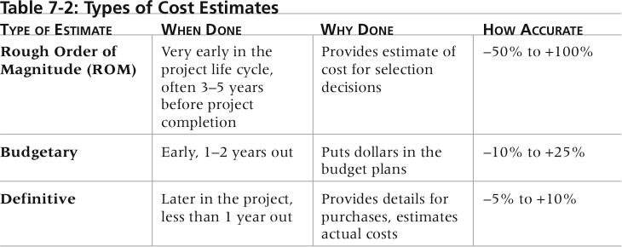
Types of Cost Estimates
It is important to provide supporting details (assumptions, project scope, WBS, etc) used in computing estimates so that it will be easier to prepare updates as needed or similar estimates on other projects.

Slide 21
Cost Management Plan
A cost management plan is a document that describes how the organization will manage cost variance on the project
For example, how to respond to proposals from suppliers that are higher or lower than estimates
A large percentage of total project costs are often labor costs, so project managers must develop and track estimates for labor
Many organizations estimate the number of people or hours they need by department or skill over the life cycle of a project

Slide 22
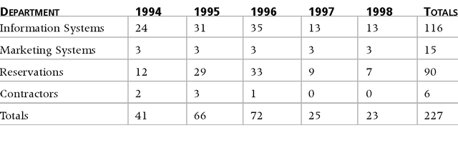
Maximum Departmental Headcounts by Year
The table below shows the maximum number of people Northwest Airlines determined to assign to each year of the project by department
Note the small number of contractors; contractors generally have higher labor costs than in-house employees

Slide 23
Cost Estimation Tools and Techniques
Analogous or top-down estimates: use the actual cost of a previous, similar project as the basis for estimating the cost of the current project
How similar the current and previous project are determines the accuracy of the estimate. Using a different language or hardware can skew the estimate
Bottom-up estimates or Activity Based Costing : involve estimating individual work items or activities and summing them to get a project total
The smaller the work items, the better the estimate but these estimates are usually time intensive and expensive to develop

Slide 24
Cost Estimation Tools and Techniques
Parametric modeling: uses project characteristics (parameters) in a mathematical model to estimate project costs
For example, a model might provide an estimate of $50 per line of code for a s/w development project based on the programming language, level of expertise of the programmers, size and complexity of the data involved, etc
Some models may be simpler such as a $10,000 ballpark estimate per workstation in a large office automation project based on history of similar projects during the same time period

Slide 25
Typical Problems with IT Cost Estimates
Estimates are done too quickly
Many estimates must be done quickly, before clear system requirements have been produced
Lack of estimating experience
The people developing the costs estimates often don’t have much experience, especially on large projects
There is not enough accurate, reliable project data available on which to base estimates
Human beings are biased toward underestimation
Senior team members make estimates based on their skill level but should take into account the junior people on the project
Management desires accuracy but wants to spend less in order to win a bid or internal funding
Top management never forgets the first estimate and rarely, if ever, remembers how approved changes affect the estimate.
The PM must keep the communication lines open at all times
_______________________________________________________________

Slide 26
Sample Cost Estimate
Before creating an estimate, know what it will be used for, gather as much information as possible, and clarify the ground rules and assumptions for the estimate
If possible, estimate costs by major WBS categories
Create a cost model to make it easy to make changes to and document the estimate

Slide 27
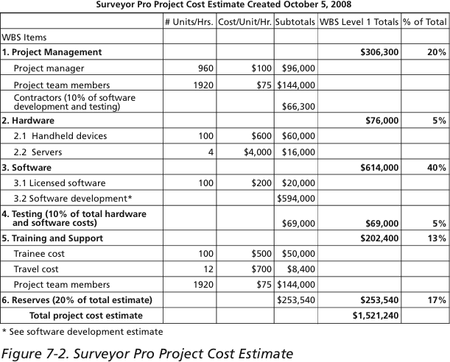
Surveyor Pro Project Cost Estimate

Slide 28
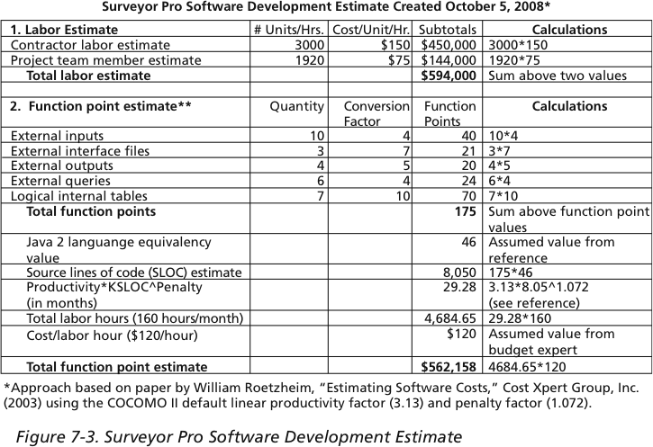
Surveyor Pro Software Development Estimate

Slide 29
Cost Budgeting
Cost budgeting involves allocating the project cost estimate to individual work items over time
The WBS is a required input to the cost budgeting process since it defines the work items
An important goal is to produce a cost baseline
A time-phased budget that project managers use to measure and monitor cost performance
Estimating costs for each major project activity over time provides management with a foundation for project cost control
Cost budgeting also provides info for project funding requirements –at what point(s) in time will the money be needed

Slide 30
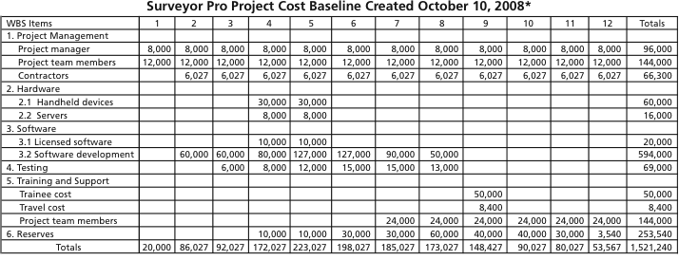
Surveyor Pro Project Cost Baseline
The Surveyor Pro project team could use the cost estimate along with the project schedule and other info to allocate costs for each month as below
*Numbers are rounded, so some totals appear to be off.

Slide 31
Cost Control
Project cost control includes:
Monitoring cost performance
Ensuring that only appropriate project changes are included in a revised cost baseline
Informing project stakeholders of authorized changes to the project that will affect costs
Many organizations around the globe have problems with cost control

Slide 32
Media Snapshot
Australia: problems with the installation of an ERP system at Crane Group Ltd. led to an estimated cost overrun of $11.5 million
India: as many as 274 projects currently under implementation in the Central sector are suffering serious cost and time overruns. Only 65 are being monitored on a regular basis
Pakistan: Pakistan has sustained a cost overrun of Rs 1.798 billion (over $30 million U.S. dollars) in the execution of the 66.5 megawatt Jagran Hydropower Project in the Neelum Valley. Caused by massive mismanagement, embezzelment of funds and unapproved changes in the project
United States: Northern California lawmakers were outraged over Governor Arnold Schwarzenegger's announcement that commuters should have to pay construction costs on Bay Area bridges. Cost of one of the bridges has grown from $1.1 billion to $5.1 billion Maybe it takes the Terminator to help control costs!

Slide 33
Cost Control
Performance review meetings can be a powerful tool to help control project costs
Knowing you have to report on your progress is an incentive for people to perform better
Performance measurement is another important tool for cost control
There are many general accounting approaches for measuring cost performance but earned value management is a tool unique to project management

Slide 34
Earned Value Management (EVM)
EVM is a project performance measurement technique that integrates scope, time, and cost data
Given a baseline (original plan plus approved changes), you can determine how well the project is meeting its goals
You must enter actual information periodically to use EVM
Was a WBS item completed or approximately how much of the work was completed
Actual start and end dates
Actual cost
More and more organizations around the world are using EVM to help control project costs

Slide 35
Earned Value Management Terms
The planned value (PV), formerly called the budgeted cost of work scheduled (BCWS), also called the budget, is that portion of the approved total cost estimate planned to be spent on an activity during a given period
Actual cost (AC), formerly called actual cost of work performed (ACWP), is the total of direct and indirect costs incurred in accomplishing work on an activity during a given period
$20,000 AC to accomplish task over two weeks - $15K AC week 1and $5K week 2
The earned value (EV), formerly called the budgeted cost of work performed (BCWP), is an estimate of the value of the physical work actually completed
EV is based on the original planned costs for the project or activity and the rate at which the team is completing work on the project or activity to date

Slide 36
Rate of Performance
Rate of performance (RP) is the ratio of actual work completed to the percentage of work planned to have been completed at any given time during the life of the project or activity
Brenda Taylor, Senior Project Manager in South Africa, suggests this term and approach for estimating earned value
For example, suppose the server installation was halfway completed by the end of week 1; the rate of performance would be 50% because by the end of week 1, the planned schedule reflects that the task should be 100% complete and only 50% of that work has been completed
The EV would thus be $5,000 after week 1 ($10,000*50%)

Slide 37
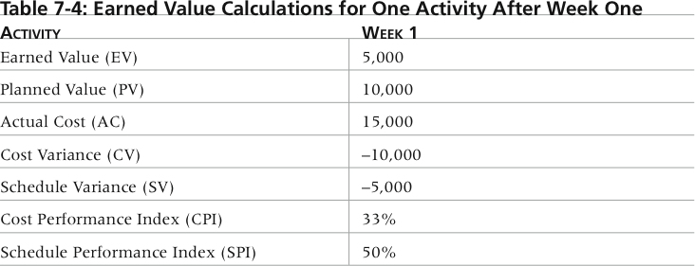
Earned Value Calculations for One Activity After Week One

Slide 38
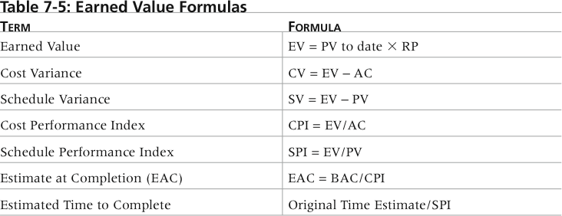
Earned Value Formulas

Slide 39
Earned Value Formulas
Negative numbers for cost and schedule variance indicate problems in those areas
If CV is negative it means that performing the work cost more than planned
A negative SV means that it took longer than planned to perform the work
CPI can be used to estimate the projected cost of completing the project based on performance to date (EAC)
=1:the planned and actual costs are the same; <1: over budget; >1: under budget
SPI can be used to estimate the projected time to complete the project
=1: on schedule; <1 behind schedule; >1 ahead of schedule

Slide 40
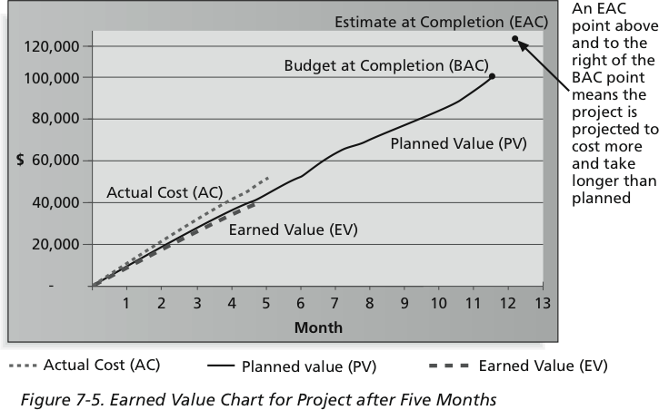
Earned Value Chart for Project after Five Months
EAC = $122,308 = BAC/CPI = $100,000/.81761
ETC = 12.74 months = Original Time Estimate/SPI = 12 months/.94203

Slide 41
Earned Value Chart
The chart helps visualize how the project is performing.
If the project goes as planned, it will finish in 12 months at a cost of $100,000
The actual cost line is always right on or above the earned value line.
Interpretation: This means costs are equal to or more than planned
The planned value line is pretty close to the EV line, just slightly higher in the last month
Interpretation: The project has been right on schedule until last month when the project fell behind schedule

Slide 42
Earned Value Chart
Many commercial organizations do not use EV management
Because IT projects do not have good planning information, tracking performance against a plan might produce misleading information
Estimating percentage completion of tasks might also produce misleading information.
What does it mean to say a task is 75% complete after 3 months? 1 more month is needed to finish? Will finish after spending an additional 25% of the planned budget? Could very well be no to both of those question.
To simply EV management,
Use percentage completion of 0(not started), 50 (in progress) and 100 (completed)
Or, enter and collect EV data at summary levels of the WBS

Slide 43
Project Portfolio Management
Many organizations collect and control an entire suite of projects or investments as one set of interrelated activities in a portfolio
Five levels for project portfolio management
Put all your projects in one database
Prioritize the projects in your database
Divide your projects into two or three budgets based on type of investment
Automate the repository
Apply modern portfolio theory, including risk-return tools that map project risk on a curve

Slide 44
Benefits of Portfolio Management
Schlumberger saved $3 million in one year by organizing 120 information technology projects into a portfolio
80% of the prjects overlapped
14 separate projects were trying to accomplish the same thing
META Group research shows that:
Organizations that evaluate information technology projects by what their business impacts are and what their potential business values will be implement projects that result in 25 percent more improvement to the bottom line
Business executives state that using project portfolio management allows managers to make decisions faster and with more confidence

Slide 45
Best Practice
A global survey released by Borland Software in 2006 suggests that many organizations are still at a low level of maturity in terms of how they define project goals, allocate resources, and measure overall success of their information technology portfolios
Some of the findings include the following:
Only 22 percent of survey respondents reported that their organization either effectively or very effectively uses a project plan for managing projects
Only 17 percent have either rigorous or very rigorous processes for project plans, which include developing a baseline and estimating schedule, cost, and business impact of projects
Only 20 percent agreed their organizations monitor portfolio progress and coordinate across interdependent projects
The most successful organizations are taking a holistic view of focusing, managing and measuring their IT efforts with an integrated combination of best practice processes, training and technology

Slide 46
Best Practice
The most successful organizations are taking a holistic view of focusing, managing and measuring their IT efforts with an integrated combination of best practice processes, training and technology
Unfortunately, most organizations today are not taking that approach

Slide 47
Using Software to Assist in Cost Management
Spreadsheets are a common tool for resource planning, cost estimating, cost budgeting, and cost control
Many companies use more sophisticated and centralized financial applications software for cost information
Project management software has many cost-related features, especially enterprise PM software
Several companies have developed methods to link data between their project management software and their main accounting systems

Slide 48
They suggest 4 dimensions that are important:
focusing on managing strategy and stakeholders instead of exclusively concentrating on budget and scheduling
mastering technology and project content by securing critical internal and external talent
building effective teams by aligning their incentives with the overall goals of projects
excelling at core project-management practices, such as short delivery cycles and rigorous quality checks

